Slide 1
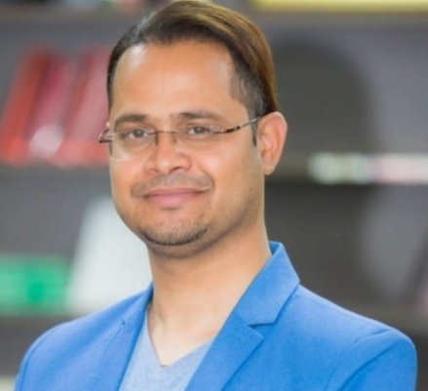
MR. SUMAN THAPALIYA
MSC. IT, PhD Scholars (Lincoln University)
PROFESSIONAL CERTIFICATIONS: CEI, CEH, ISO 27001 – 2013 (LEAD AUDITOR), CCNA, RHCE, CISA, CISM, CISO, CCSP, CISSP, CRISC, COMPTIA+ 901/ 902, AWS, WINDOWS FORENSIC TESTER, PHYSICAL PENETRATION TESTER, ADVANCED PENETRATION TESTER, OWASP
HAMRO GHAR.COM

Slide 2
INTRODUCTION
6 Line 7 Words

Slide 3
BACKGROUND
Background of Your Project Title.

Slide 4
LITERATURE REVIEW
https://kumararticle.art.blog/?fbclid=IwAR3fwbcqBkkR95jPwZ8-nYw-MTS47COG-e2QK0my1I5CPznKbr7m_Pqt924.

Slide 5
ANALYSIS

Slide 6
COMPARISION

Slide 7
REFERENCES
Wikipedia. 2019. Internet - Wikipedia. [ONLINE] Available at: https://en.wikipedia.org/wiki/Internet. [Accessed 21 November 2019].

Slide 8
BIBLIOGRAPHY
Internet Computer Network , Michael Aaron Dennis Robert Kahn (2012)

